Slide 1
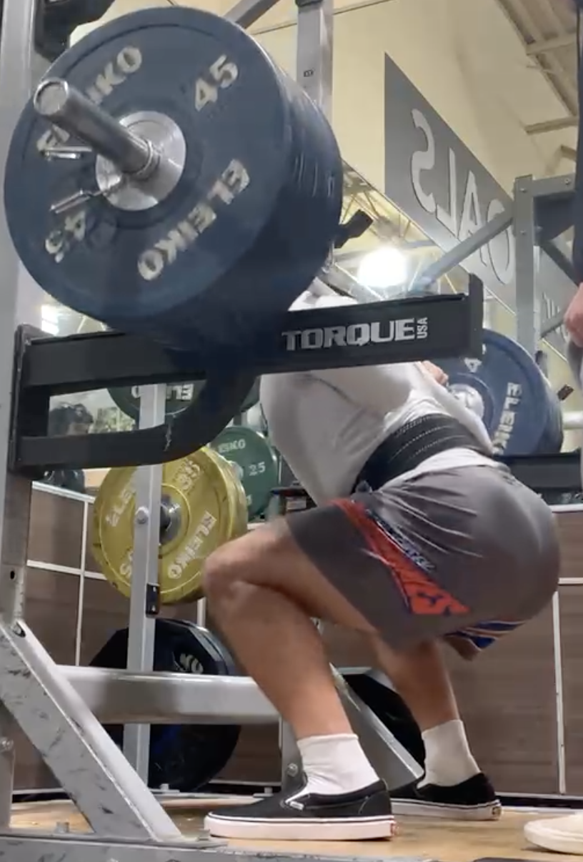
Jason is lifting 3x his body weight
This picture is not at the best angle
System: whole person
Force Equilibrium Eqn.
ΣF = 0
F_{barbell}
F_{barbell} = 3W_{body}
+
n_{right}
+
+
W_{body}
= 0
n_{left}
W_{body}
n_{right}
n_{left} = ? W_{body}
n_{left}
n_{left}
n_{right}
=
Assume

Slide 2
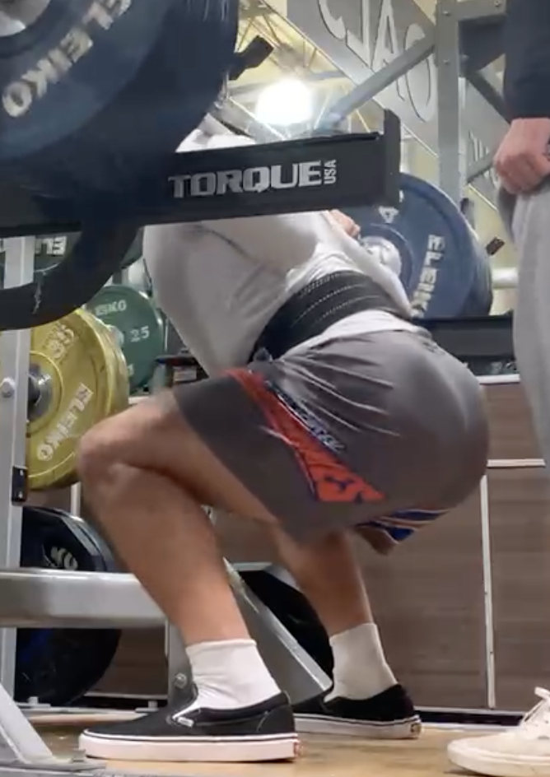
Drag Outline to indicate Torque rotation direction of n_{left} in each case
Lever system: whole leg
Joint axis: hip
Lever system: lower leg
Joint axis: knee
Lever system: foot
Joint axis: ankle
Dorsiflexion
Flexion
Flexion
Plantar flexion
Extension
Extension
n_{left}
n_{left}
n_{left}

Slide 3
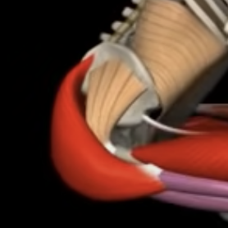
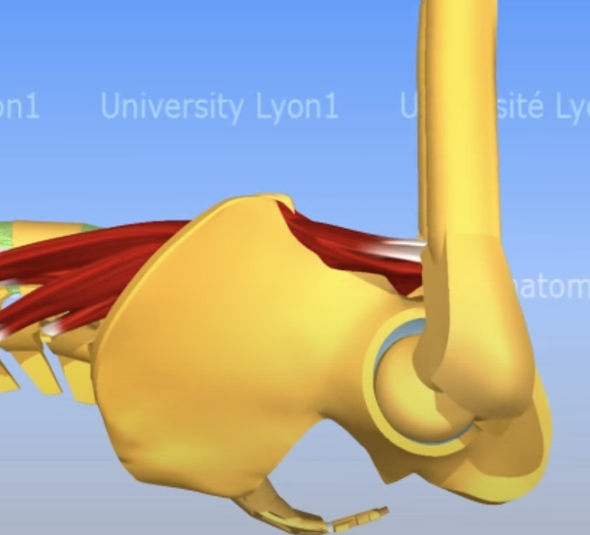
Lever system: whole leg
Joint axis: hip
What muscle can exert a counter torque to the floor force (n_{floor}) on the whole leg around the hip?
glute
psoas
Flexion
psoas
Flexion
glute
Extension
Extension
Drag muscle vectors and torque directions
n_{left}
n_{left}

Slide 4
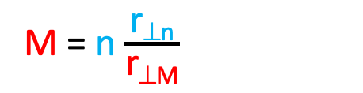
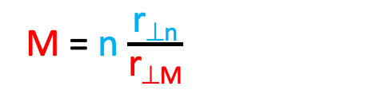
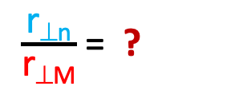
Limb System : whole leg
Joint: hip
Muscle:
Torque Equilibrium Eqn.
Στ = 0
τ_{M} = τ_{floor}
n_{left}= ? W_{body}
n r_{⊥n} = M r_{⊥M}
Isolating for unknown M
M = n $\frac{\text{r}\text{⊥}\text{n}}{\text{r}\text{⊥}\text{M}}$
r⊥
Estimate ratio of lever arms
$\frac{\text{r}\text{⊥}\text{n}}{\text{r}\text{⊥}\text{M}}$ = ?
r⊥
Calculate estimate for muscle force
M = n $\frac{\text{r}\text{⊥}\text{n}}{\text{r}\text{⊥}\text{M}}$
n_{left}
M = n * ?
Drag muscle vector and lever arms
M = ? W_{body}

Slide 5
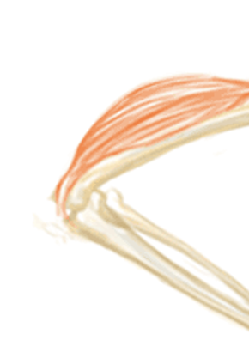
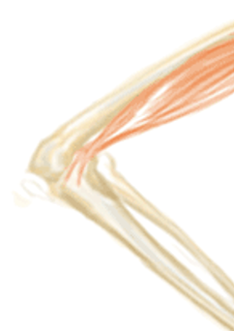
Lever system: lower leg/foot
Joint axis: knee
What muscle can exert a counter torque to the floor force (n_{floor}) on the lower leg around the knee?
hamstrings
quads
Flexion
quads
Flexion
hamstrings
Extension
Extension
n_{left}
Drag muscle vectors and torque directions
n_{left}

Slide 6
Limb System : lower leg/foot
Joint: knee
Muscle:
Torque Equilibrium Eqn.
Στ = 0
τ_{M} = τ_{floor}
n_{left} = ? W_{body}
n r_{⊥n} = M r_{⊥M}
Isolating for unknown M
M = n $\frac{\text{r}\text{⊥}\text{n}}{\text{r}\text{⊥}\text{M}}$
r⊥
Estimate ratio of lever arms
$\frac{\text{r}\text{⊥}\text{n}}{\text{r}\text{⊥}\text{M}}$ = ?
r⊥
Calculate estimate for muscle force
M = n $\frac{\text{r}\text{⊥}\text{n}}{\text{r}\text{⊥}\text{M}}$
n_{left}
M = n * ?
Drag muscle vector and lever arms
M = ? W_{body}

Slide 7
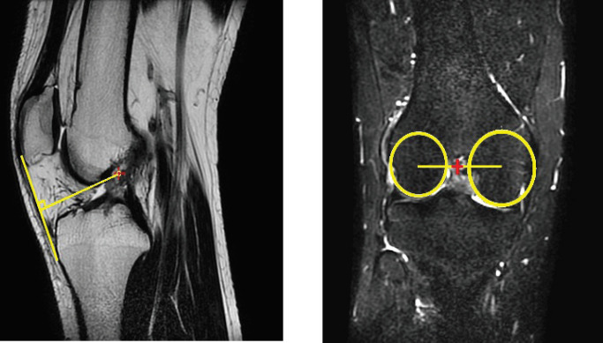
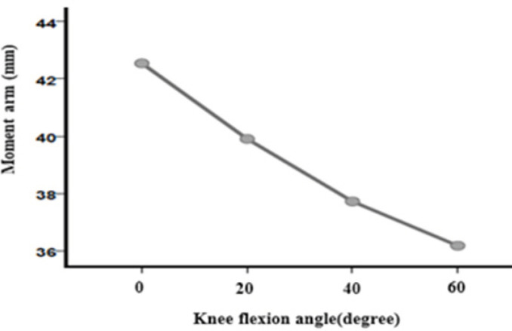
Lever arm of quad depends on angle the leg is bent
https://www.ncbi.nlm.nih.gov/pmc/articles/PMC7547162/
Lever arm is sometimes referred to as “moment arm”

Slide 8
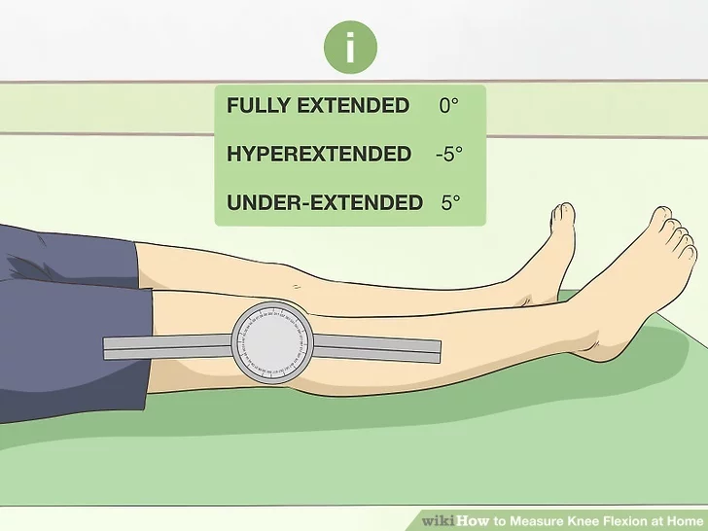
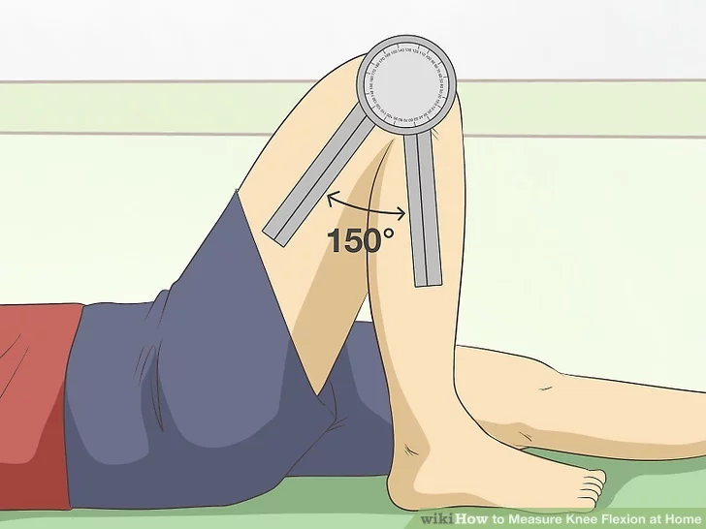
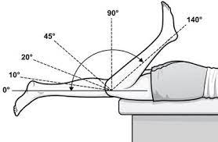
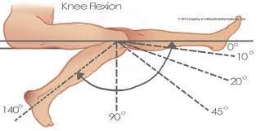
Zero angle is when limb is straight
https://www.wikihow.com/Measure-Knee-Flexion-at-Home

Slide 9
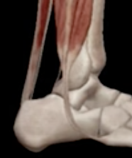
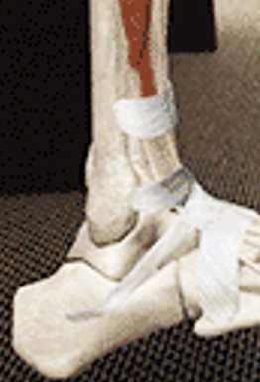
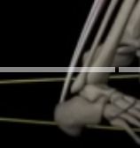
Lever system: foot
Joint axis: ankle
What muscle can exert a counter torque to the floor force (n_{floor}) on the foot around the ankle?
Achilles/calf
Tibialis
Dorsiflexion
Dorsiflexion
Plantar flexion
Plantar flexion
Achilles/calf
n_{left}
Tibialis
Drag muscle vectors and torque directions
n_{left}

Slide 10
Limb System : foot
Joint: ankle
Muscle:
Torque Equilibrium Eqn.
Στ = 0
τ_{M} = τ_{floor}
n_{left}= ? W_{body}
n r_{⊥n} = M r_{⊥M}
Isolating for unknown M
M = n $\frac{\text{r}\text{⊥}\text{n}}{\text{r}\text{⊥}\text{M}}$
r⊥
Estimate ratio of lever arms
$\frac{\text{r}\text{⊥}\text{n}}{\text{r}\text{⊥}\text{M}}$ = ?
r⊥
Calculate estimate for muscle force
M = n $\frac{\text{r}\text{⊥}\text{n}}{\text{r}\text{⊥}\text{M}}$
M = n * ?
Drag muscle vector and lever arms
M = ? W_{body}
n_{left}

